Slide 1
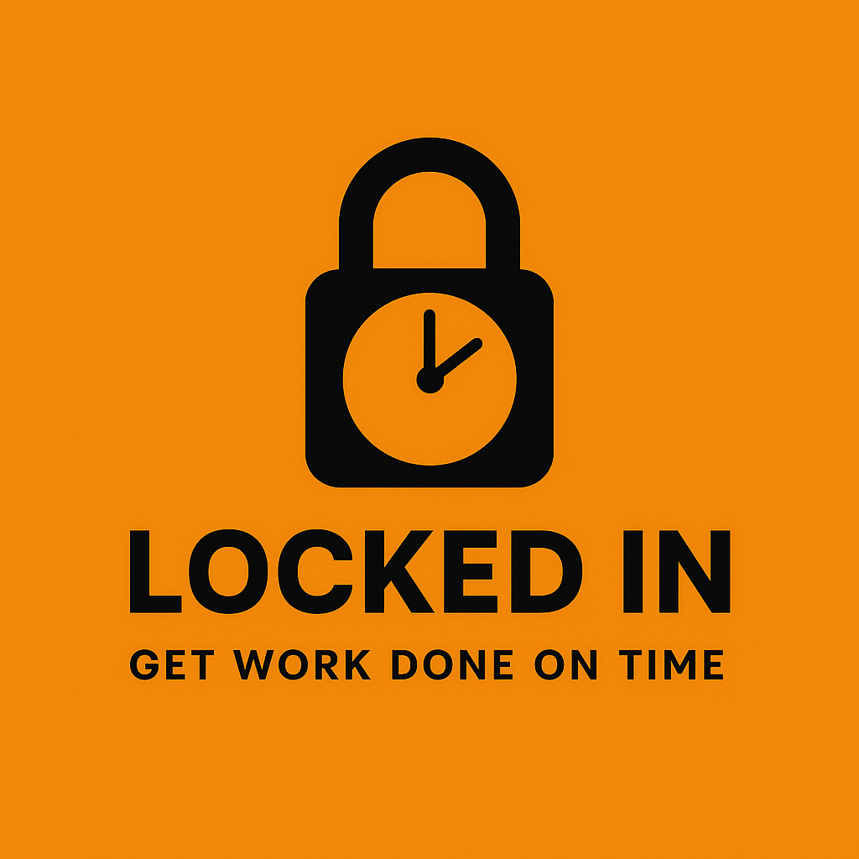
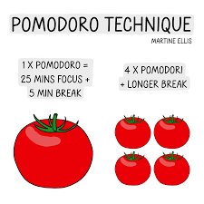
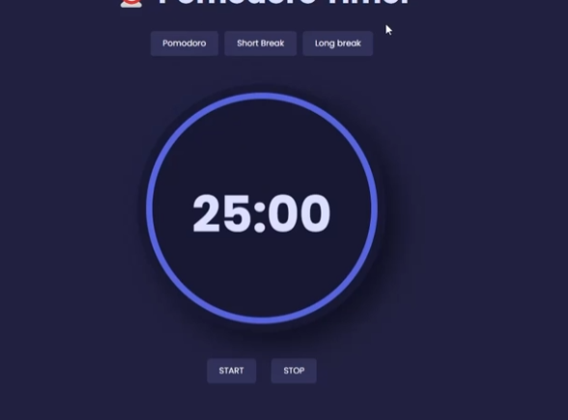
Locked in
Created by Austin Reynolds
“Only way to get work done the right way is to LOCK IN”
With so many ways to be distracted from doing necessary work, implementing a simple work strategy can make doing homework or even simple chores, a stress-free healthy environment. The need for stress due to cramming and procrastination can lead to many other issues, and this program is a step in the right direction.
Inspiration based on the Pomodoro Technique

